Slide 1

Currency over Time
Project 1
Brittany, David, Elvis, Jean, Lulu & Marvin

Slide 2
Intro- David
Currency Exchange
Fluctuations effects, initial questions:
Other effects questions:
Currency foreign exchange determines value of foreign investments, also it is an indicator of the relative level of economic health of one country and its people. Due to the special role this play in the country’s trade level.
Volatile and high exchange rate discourages foreign investment, stable and low exchange rate encourages them.
Our group selected the US dollar, Japanese yen, Great British pound, and Chinese Yuan, to determine fluctuations among them for the period 2005-2015, and explore relationships between currency exchange and traveling, and its effects over GDP and GDP over Unemployment.
Initial
-Do fluctuations from one dominant currency affect simultaneously other related currencies? What causes these fluctuations?
-Do fluctuations in dollar currency have a traveling effect to and from the US?
-Does Travel/Tourism have an positive impact in relation to GDP?
-Is unemployment inversely proportional to GDP?
Notes:
3 Min

Slide 3
Code & Data Sets Used- Marvin
Analyses:
Volatility of currency over time
Correlation between currency rates and travel to & from the United States
Correlation between tourism spending and GDP in the United States
Correlation between GDP and unemployment
Data:
Forex currency exchange data (monthly, pulled using an api)
Travel data and import/export data from the NTTO (monthly, csv)
GDP data from the World Bank (yearly, excel)
Unemployment data from the BLS (monthly, excel)
Notes:
2 min

Slide 4
Data Cleaning Process- Marvin
Our data sets were fortunately fairly clean when pulled and mostly only required some basic manual extraction of the dates and countries we wished to look at or simple data type conversion. The forex data did, however, require some cleaning using regular expressions in pandas to isolate the month and year as well as separating the currency symbol from the value.

Slide 5
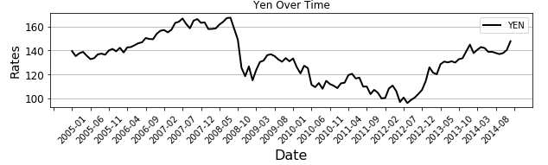
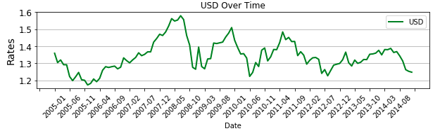
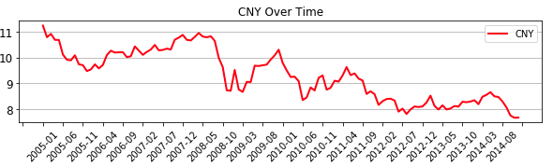
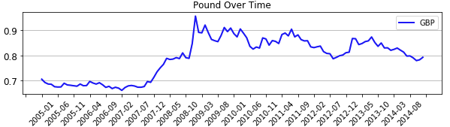
Currency fluctuation over time (YEN, USD, CNY, GBP)- Jean
Matpoltlib line graph using CSV data
Notes:
1 min
We plotted four most used currency worldwide
Events that affected Yen GDP= 2011- 9.0 Tohoku Earthquake and Tsunami- that caused fatal casualty to be estimated 16K
Events that affected USD GDP= Recession due to the Fannie Mae/Freddie Mac 2006-2008- and bailout. Obama becomes POTUS. Worldwide event with Greece’s sky rocking Debt Crisis in 2008
Events that affected CNY- China pegs the Yuan against USD as an emergency measure to help stabilize their economy amind the global financial economic crisis- in 2010- China’s central bank and Hong Kong agree to expand the scope of the Yuan and trading takes an explosive takeoff.
The GPB has always been a strong currency and comparable to the Euro and USD, slight dips during the BP oil leak in 2010- but starting from the Brexit transition, the pound has been more volatile and the where once the GBP was holding steady- has been losing their grip in the past ten years.

Slide 6
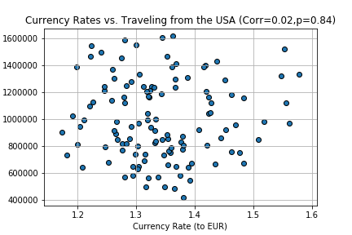
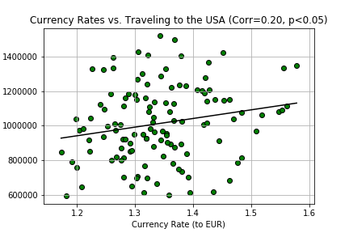
Travel Departures from the US
-Lulu
Travel Arrivals to the US
Matpoltlib scatter plotting using CSV data
Notes:
1 min

Slide 7
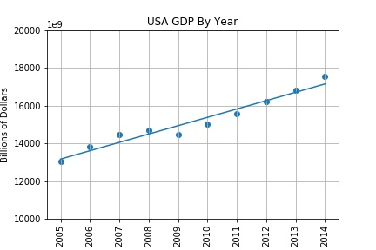
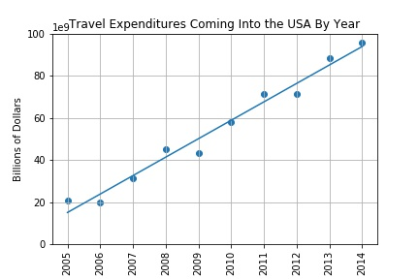
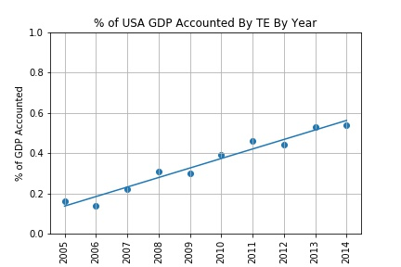
GDP and Travel Expenditure- Marvin
Matpoltlib scatter plots using CSV and excel data
Notes:
1 min

Slide 8
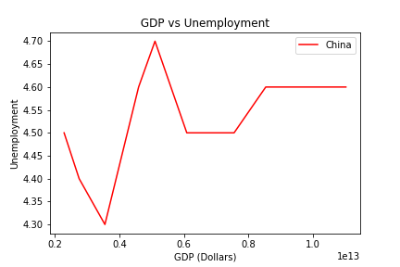
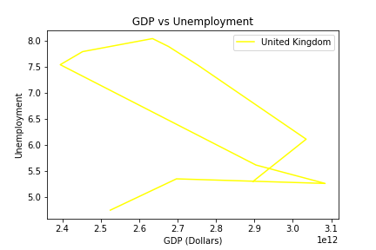
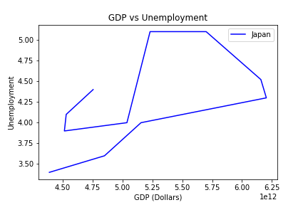
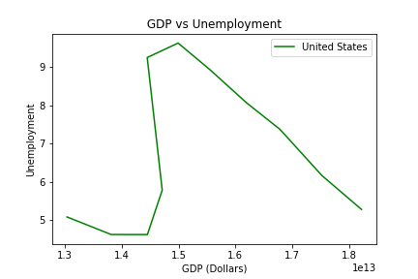
GDP and Unemployment- Elvis
Matpoltlib scatter plotting using CSV data
Notes:
1 min
China, USA, UK graphs show the effect of economic recession over unemployment almost at the same time.
For Great britain we can see it took them longer to get control of their unemployment numbers.
It seems that China set unemployment target for the last portion of this period as their figures remain constant.
Japan graphs show the effects of their 2011 natural disasters over their GDP.
As a conclusion:
Strong GDP growth follows a reduced number of unemployment, and to a weak or negative GDP growth will follow higher number of unemployment.

Slide 9
Our Sources
https://fixer.io/ - currency rates
https://travel.trade.gov/research/monthly/arrivals/index.asp - Arrivals and Departures in/outside the US
https://travel.trade.gov/outreachpages/inbound.general_information.inbound_overview.asp - travel import/export in the US
https://data.worldbank.org/indicator/NY.GDP.MKTP.CD - GDP
https://datacatalog.worldbank.org/dataset/world-development-indicators - GDP
https://data.bls.gov/pdq/SurveyOutputServlet - Unemployment rates in the US

